Slide 1
jQuery Begins
Lesson 5.1

Slide 2
Admin Items
jQuery $(Begins)

Slide 3

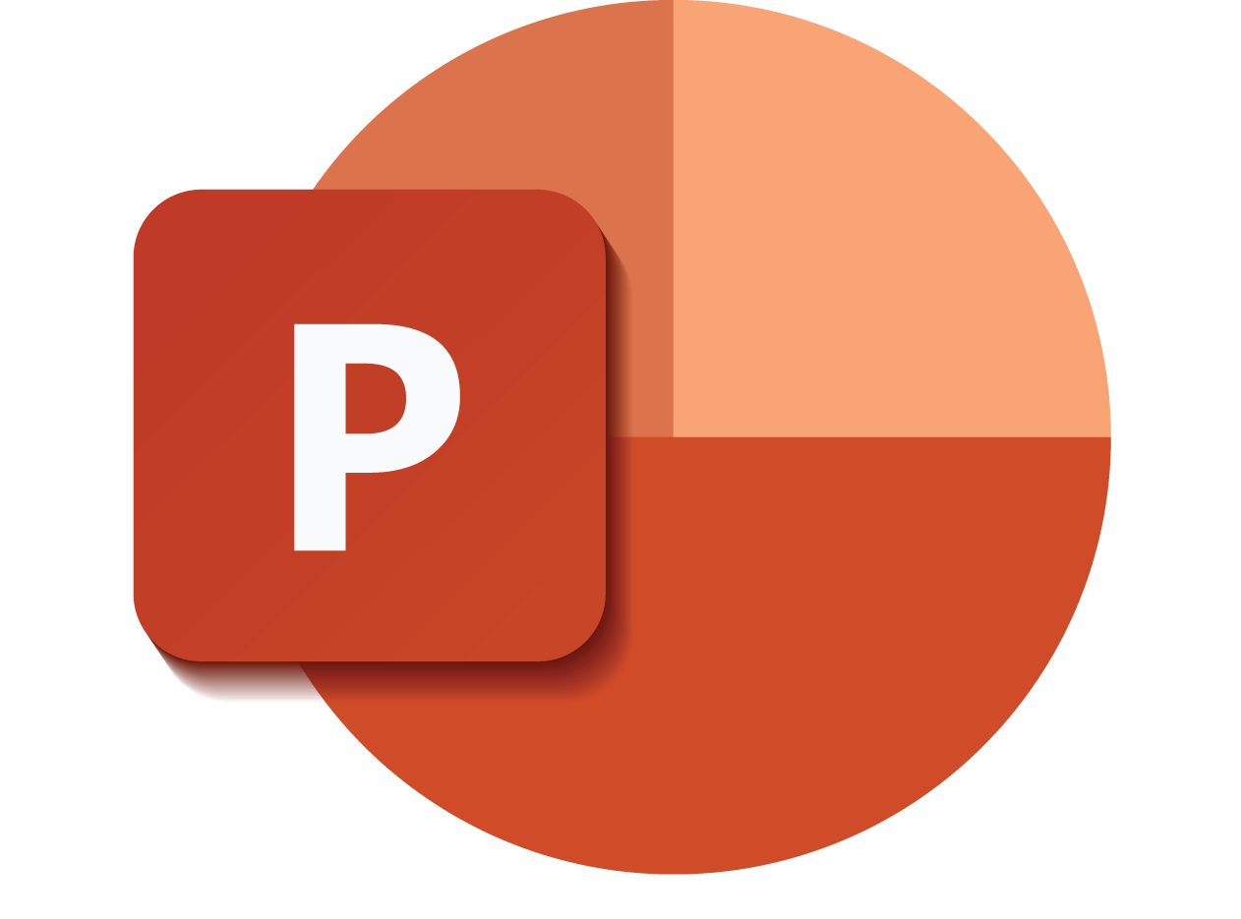
Death by PowerPoint: Not the Way to Learn Coding
jQuery $(Begins)
Notes:
Image from: shutterstock_470084681

Slide 4

True Way to Learn Coding
jQuery $(Begins)
Notes:
Image from: shutterstock_589180820

Slide 5
Be prepared to have classes that are increasingly “just code.”
(You will appreciate it in the long run.)
jQuery $(Begins)

Slide 6
Today’s Class
jQuery $(Begins)

Slide 7


Agenda
In today’s class we’ll be covering:
DOM manipulation using plain JavaScript
DOM manipulation using jQuery
Responding to click events
jQuery $(Begins)

Slide 8
DOM Manipulation
jQuery $(Begins)

Slide 9
Understanding the DOM
Basic Example: todomvc.com
Every HTML page begins as static content.
However, with Javascript/jQuery, we can modify the DOM and change this static content in real time.
This allows us to build dynamic sites.
jQuery $(Begins)

Slide 10
15 minutes
Activity: Generating HTML with Plain JavaScript
jQuery $(Begins)

Slide 11

Activity: Generating HTML with Plain JavaScript
Suggested Time: 15 minutes
Using the file sent to you as a starting point, add the missing code so that your JavaScript generates HTML content that displays all drink options.
Hint: You will need a for loop. Inside the for loop, you will need to use each of the following methods: createElement, innerHTML, and appendChild.
jQuery $(Begins)

Slide 12
Intro to jQuery
jQuery $(Begins)

Slide 13

Intro to jQuery
jquery.com
jQuery is a cross-platform JavaScript library designed to simplify client-side HTML scripting.
jQuery $(Begins)
Notes:
shutterstock_206072047

Slide 14
Query Helper Library
jQuery can be useful for tasks such as:
Dynamically inserting, updating, or removing HTML
Registering click or other change events
Animating HTML elements
Downloading data from databases
And much more!
jQuery $(Begins)

Slide 15
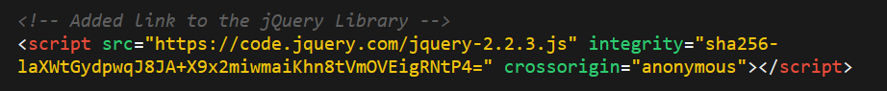
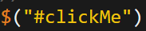
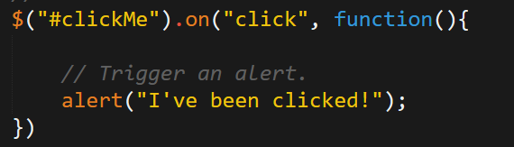
Working with jQuery
01
Include a CDN (Content Delivery Network) link to the jQuery script.
02
Utilize the jQuery specific ($) selector.
03
Apply jQuery methods on the selected elements.
jQuery $(Begins)

Slide 16
DOM Manipulation with jQuery
jQuery $(Begins)

Slide 17
Activity: Generating HTML with jQuery
15 minutes
jQuery $(Begins)

Slide 18
Activity: Generating HTML with jQuery
Suggested Time: 15 minutes
Refactor (rewrite) your previous drinkList code from earlier, but this time use jQuery to complete all of the same tasks.
Your final code should NOT have any of the following methods: createElement, innerHTML, or appendChild.
Hint: Don’t forget to “incorporate” jQuery before you begin.
Bonus: Instead of using a for loop, look up how to use the jQuery .each method.
jQuery $(Begins)

Slide 19
On-Click Basic
jQuery $(Begins)

Slide 20
Partner Activity: Sandwich Clicking
20 minutes
jQuery $(Begins)

Slide 21
Partner Activity: Sandwich Clicking
Suggested Time: 20 minutes
Add the missing code so that clicking any of the sandwiches causes:
An alert message that says something snarky about the sandwich type.
An alert message that displays how many of a specific sandwich the user has eaten.
Hint: You will need counter variables.
Bonus: Add an image to the image-div on the click event.
jQuery $(Begins)

Slide 22
Partner Activity: Trigger Random
12 minutes
jQuery $(Begins)

Slide 23
Partner Activity: Trigger Random
Suggested Time: 12 minutes
Add the missing code so that clicking the big blue button triggers a random number (between 1 and 1,000) to be selected and prominently displayed in the randomNumber div.
jQuery $(Begins)

Slide 24
Partner Activity: Lottery Generator
20 minutes
jQuery $(Begins)

Slide 25
Partner Activity: Lottery Generator
Suggested Time: 20 minutes
Use the code from the previous random number generator to create a lottery generator.
The lottery generator should select 9 random numbers (and always 9 numbers). Example: 886563264
Display this number in the randomNumber div.
When the user clicks again, create a new row with the most recent number at the top.
jQuery $(Begins)

Slide 26
Challenge: Number Checker
20 minutes
jQuery $(Begins)

Slide 27
Challenge: Number Checker
Suggested Time: 20 minutes
Based on the demonstration, create an application in which:
A computer selects a random number between 1 and 4.
The user clicks buttons numbered 1 to 4.
If the user’s number matches the computer’s number, display text informing them of this in the Result panel. Otherwise, display text informing them that they lost.
Bonus: If you finish early, try to improve the aesthetics of your app.
jQuery $(Begins)

Slide 28
Questions?
jQuery $(Begins)

